Slide 1
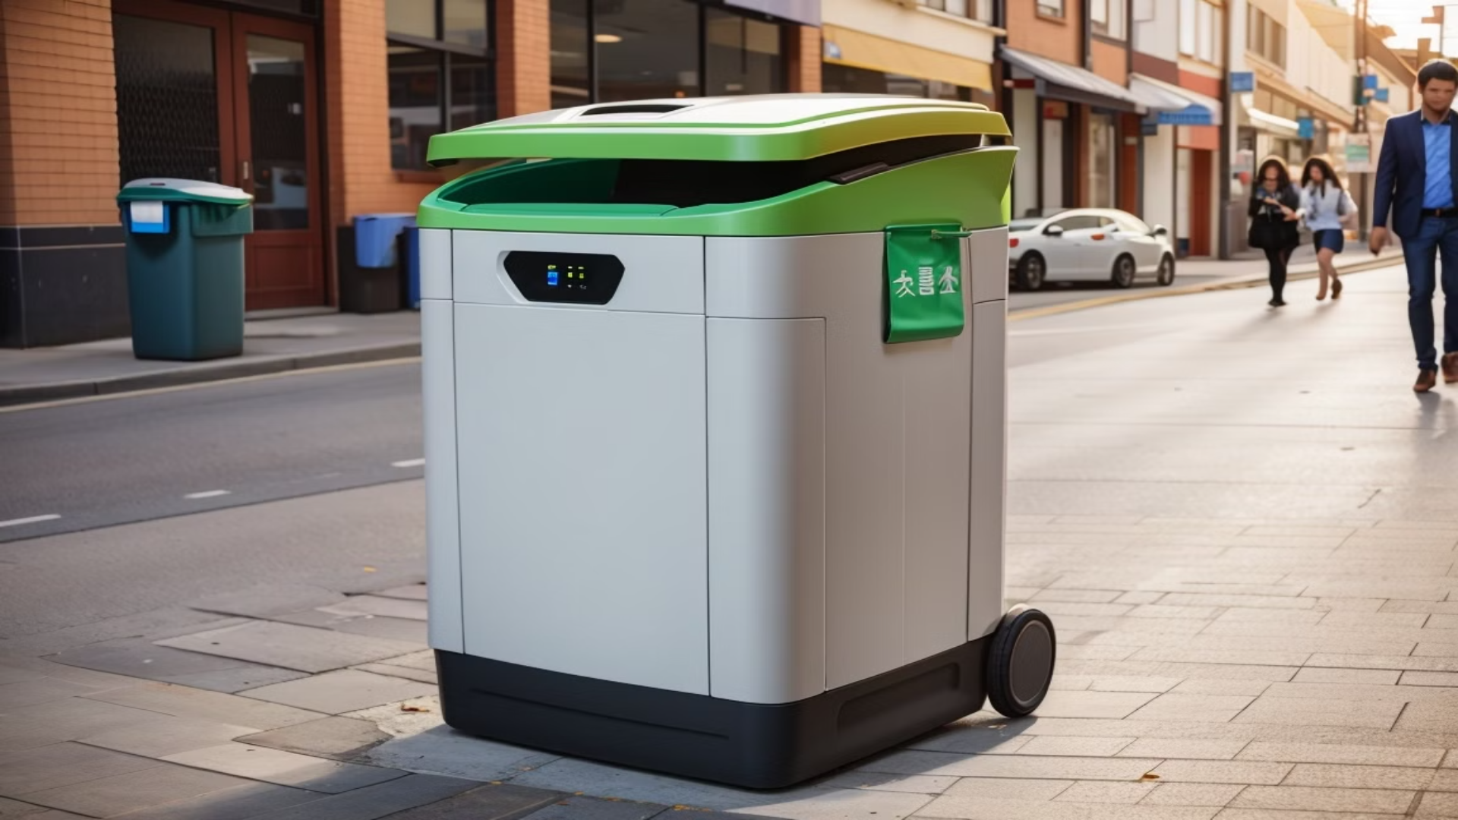
SRB
Smart Rubbish Bin

Slide 2

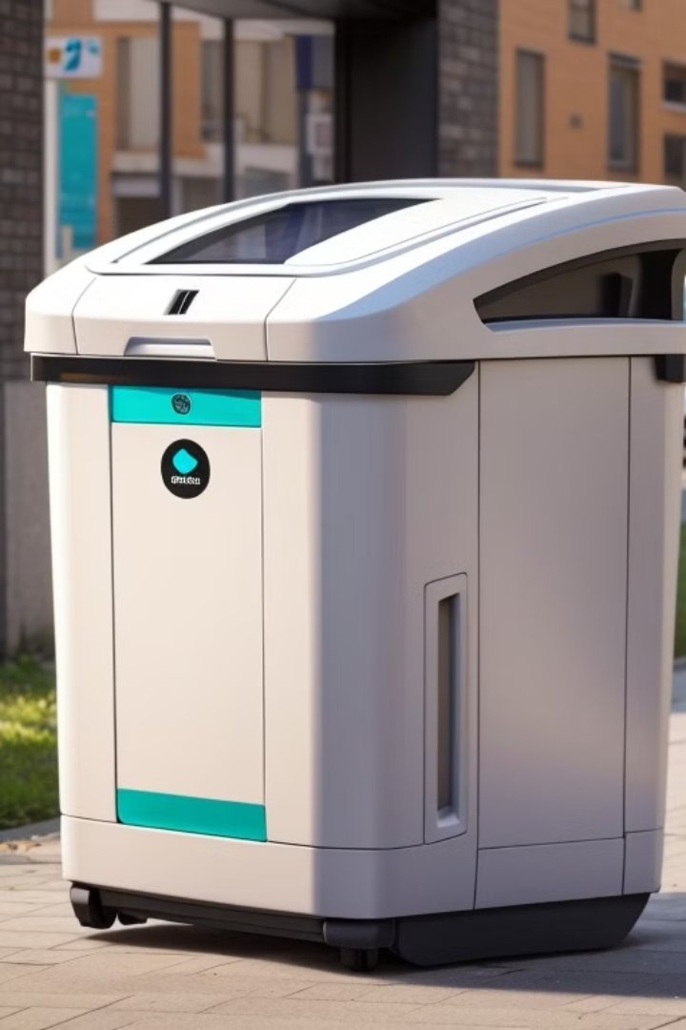
The SRB Project: Revolutionizing Waste Management in Urban Environments
The Smart Rubbish Bin Project integrates cutting-edge technology to create intelligent street baskets that facilitate efficient rubbish collection and provide real-time monitoring and data-driven insights. Join us on this journey to revolutionize waste management in urban environments.

Slide 3
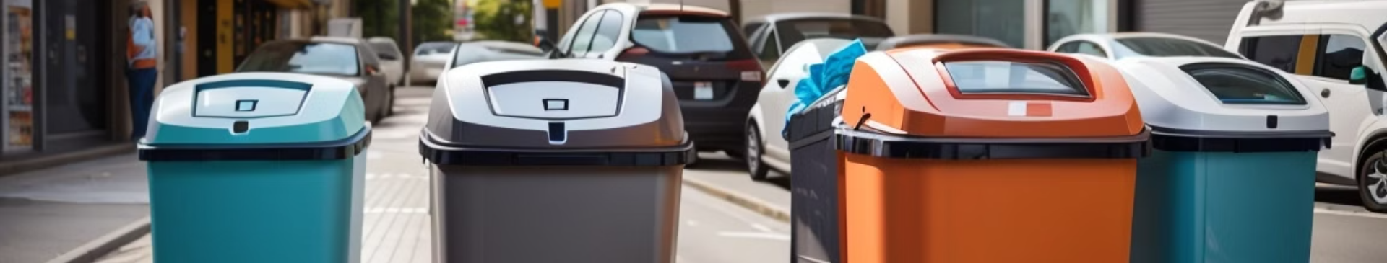
Problems
1
Mounting Waste
2
Limited Resources
3
Inadequate Monitoring
Increasing urban population leads to higher waste generation, straining conventional waste management systems.
With limited resources and outdated infrastructure, current waste management practices cannot keep up with urban demands.
The lack of accurate waste monitoring hinders timely removal and leads to overflowing bins and unsightly streets.

Slide 4
2013
2025
Total waste generated in Egypt : 89.03 million tons
Total waste generated in Egypt : 125 million tons
Municipal solid waste (MSW) : 21 million tons
Municipal solid waste (MSW) : 20 million tons
2020
Total waste generated in Egypt : 100 million tons
Municipal solid waste (MSW) : 20.7 million tons

Slide 5
12.32%
25%
2013-2020
2020-2025

Slide 6

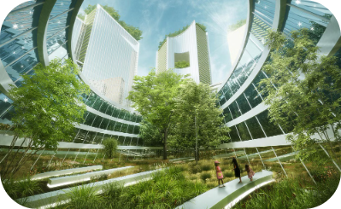
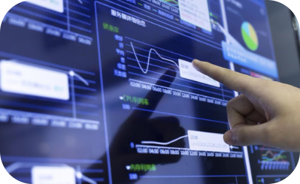
Solutions
Smart Technology Integration
Sustainable Approach
Real-Time Data Analysis
With an emphasis on sustainability, the project promotes efficient waste collection and recycling practices.
The project integrates advanced technology, including sensors and smart waste management systems.
The system provides real-time data analysis, enabling immediate responses to waste management needs.

Slide 7
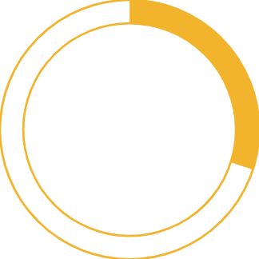
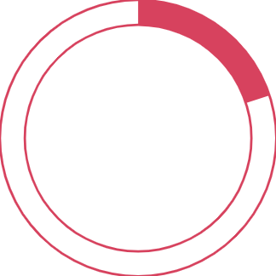
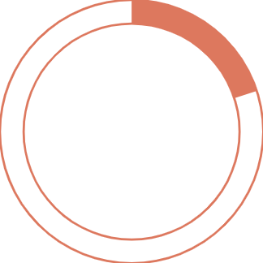
30%
20%
20%
Reduction in overflowing bins
Fuel savings
Reduction in CO2 emissions

Slide 8
Target Category
60%
40%
Sanitation Men
People
It helps them collect garbage in the fastest time and in a more accurate way, saving them from burning fuel uselessly.
It protected them from pollution and live in a safe environment without diseases that threaten their lives.

Slide 9
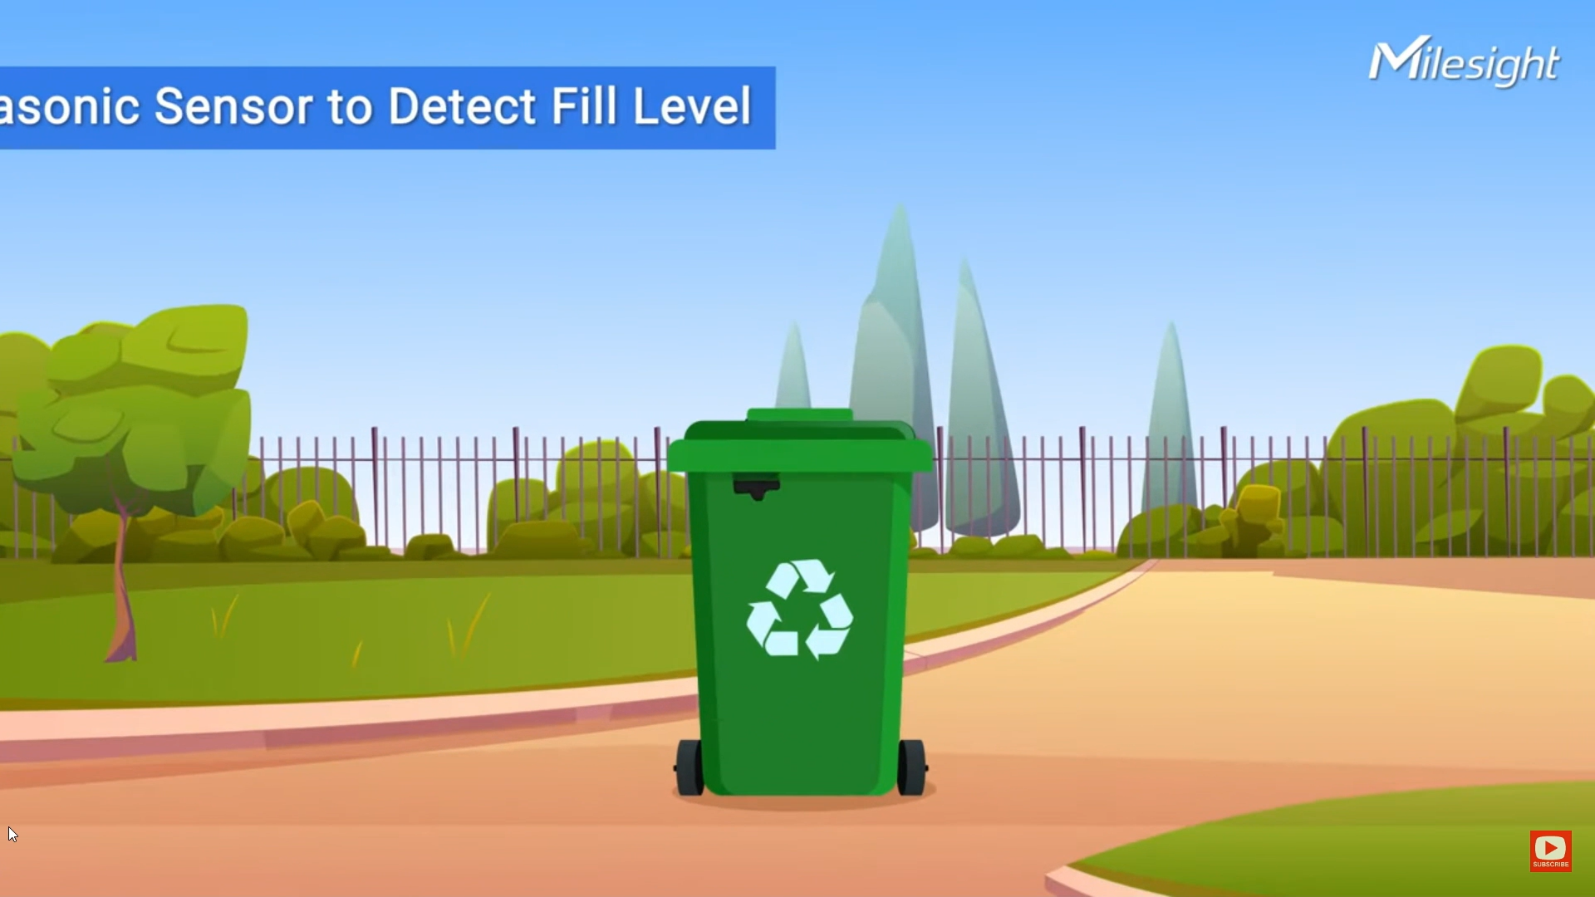
Work

Slide 10




Features
Automatic opening and closing basket
Measuring the percentage in the basket and giving warnings.
Make the rubbish pin AS online device like IOT.
Mobile application, Website interface.

Slide 11
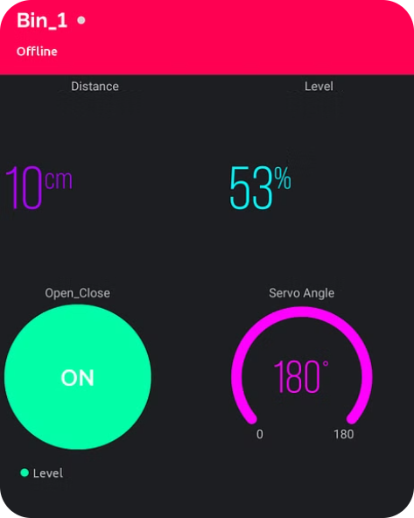
Mobile App

Slide 12
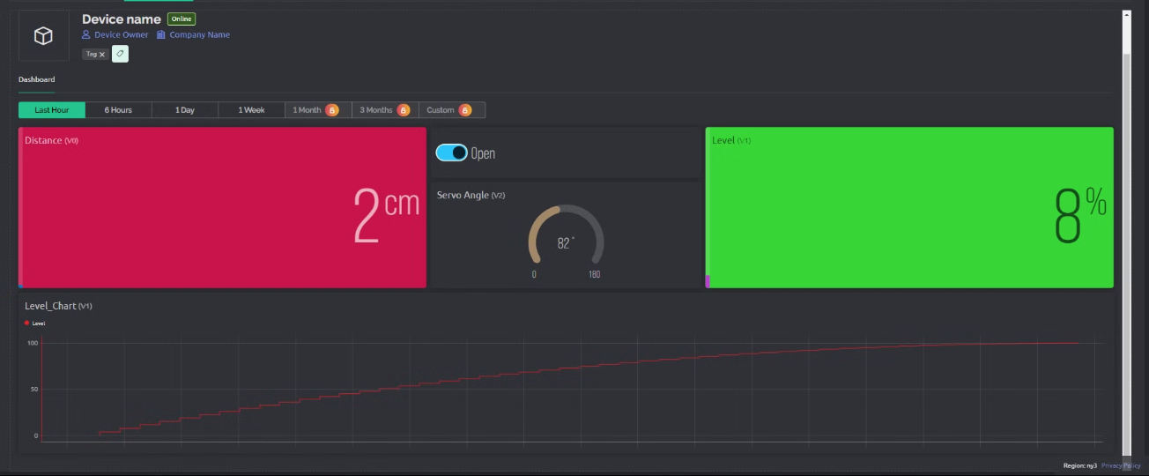
Website

Slide 13
Additional Features
1
Developing the basket to work on solar panels.
2
Adding GPS service to mobile applications and websites.
3
Provide a technical support service

Slide 14
Challanges
Task allocation
Time management
Find the courses that we need
Selection of components
Bugs in coding
Find ideas that make the project more special

Slide 15
Marketing Plan
Social media platforms
Influencer partnerships
App store and marketplaces
Competitions

Slide 16
Conclusion :
Q & A

Slide 17
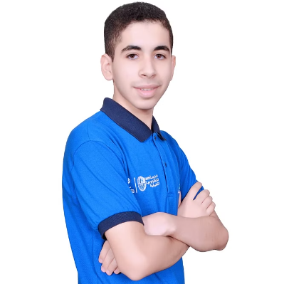

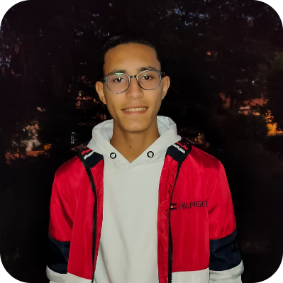
Team Work
Ziyad Walid
Adel Elsayed
Ziyad Mohamed
Leader
Member
Member

Slide 18
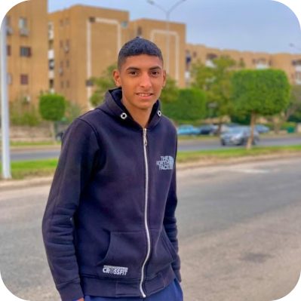
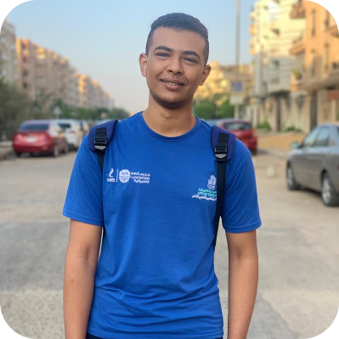
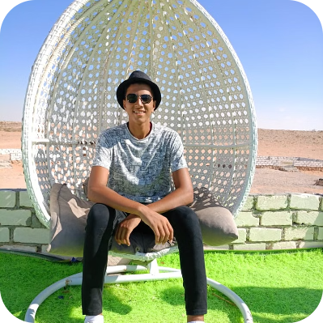
Team Work
Ibrahim Anter
Ziyad Tarek
Abdelrahman Mohey
Member
Member
Member

